Slide 1
Chapter 5 Concurrency: Mutual Exclusion and Synchronization
Operating Systems: Internals and Design Principles
Amjad Alam
Eighth Edition
By William Stallings
Notes:
“Operating Systems: Internal and Design Principles”, 8/e, by William Stallings, Chapter 5 “Concurrency: Mutual Exclusion and Synchronization”.

Slide 2
Lecture outline
Section 5.1 Mutual Exclusion: software approaches
Section 5.2 Principles of Concurrency
Section 5.3 Mutual Exclusion: hardware approaches
Section 5.4 Semaphores
Notes:
The central themes of operating system design are all concerned with the management of processes and threads:
• Multiprogramming: The management of multiple processes within a uniprocessor system
• Multiprocessing : The management of multiple processes within a multiprocessor
• Distributed processing: The management of multiple processes executing on multiple, distributed computer systems. The recent proliferation of clusters is a prime example of this type of system.

Slide 3
OS Management of Processes
Operating System design is concerned with the management of processes and threads:
Multiprogramming
The management of multiple programs (processes) within a uniprocessor system.
Multiprocessing
The management of multiple processes within a multiprocessor.
Distributed Processing
The management of multiple processes executing on multiple, distributed computer systems
The recent proliferation of clusters is a prime example of this type of system
Notes:
Distributed computing is a model in which components of a software system are shared among multiple computers or nodes.

Slide 4
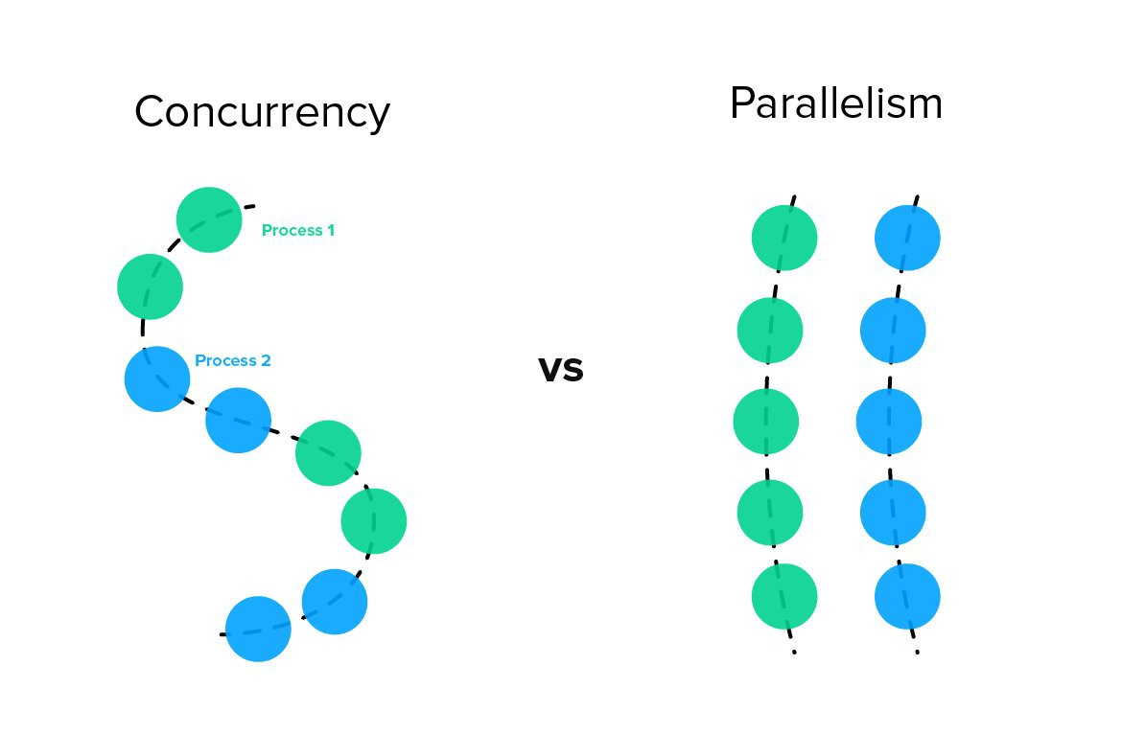
Concurrency
Concurrency: the ability to execute more than one program or task sequentially.
Notes:
Fundamental to OS design. It encompasses a host of design issues, including communication among processes, sharing of and competing for resources (such as memory, files, and I/O access), synchronization of the activities of multiple processes, and allocation of processor time to processes. We shall see that these issues arise not just in multiprocessing and distributed processing environments but even in single-processor multiprogramming systems.

Slide 5
Concurrency Arises in Three Different Contexts:
Multiple Applications
invented to allow processing time to be shared among active applications
Structured Applications
extension of modular design and structured programming
Operating System Structure
OS themselves implemented as a set of processes or threads
Notes:
Concurrency arises in three different contexts:
• Multiple applications: Multiprogramming was invented to allow processing time to be dynamically shared among a number of active applications.
• Structured applications: As an extension of the principles of modular design and structured programming, some applications can be effectively programmed as a set of concurrent processes.
Operating system structure: The same structuring advantages apply to systems programs, and we have seen that operating systems are themselves often implemented as a set of processes or threads.

Slide 6
Principles of Concurrency
Interleaving and overlapping
can be viewed as examples of concurrent processing
both present the same problems
Uniprocessor – the relative speed of execution of processes cannot be predicted
depends on activities of other processes
the way the OS handles interrupts
scheduling policies of the OS
Notes:
At first glance, it may seem that interleaving and overlapping represent fundamentally different modes of execution and present different problems. In fact, both techniques can be viewed as examples of concurrent processing, and both present the same problems. In the case of a uniprocessor, the problems stem from a basic characteristic of multiprogramming systems: The relative speed of execution of processes cannot be predicted. It depends on the activities of other processes, the way in which the OS handles interrupts, and the scheduling policies of the OS.

Slide 7
Difficulties of Concurrency
Sharing of global resources
Difficult for the OS to manage the allocation of resources optimally
Difficult to locate programming errors as results are not deterministic and reproducible
Notes:
The following difficulties arise:
1. The sharing of global resources is fraught with peril. For example, if two processes both make use of the same global variable and both perform reads and writes on that variable, then the order in which the various reads and writes are executed is critical. An example of this problem is shown in the following subsection.
2. It is difficult for the OS to manage the allocation of resources optimally. For example, process A may request use of, and be granted control of, a particular I/O channel and then be suspended before using that channel. It may be undesirable for the OS simply to lock the channel and prevent its use by other processes; indeed this may lead to a deadlock condition, as described in Chapter 6 .
3. It becomes very difficult to locate a programming error because results are typically not deterministic and reproducible (e.g., see [LEBL87, CARR89, SHEN02] for a discussion of this point).
All of the foregoing difficulties present themselves in a multiprocessor system as well, because here too the relative speed of execution of processes is unpredictable. A multiprocessor system must also deal with problems arising from the simultaneous execution of multiple processes. Fundamentally, however, the problems are the same as those for uniprocessor systems. This should become clear as the discussion proceeds.

Slide 8
Race Condition
Occurs when multiple processes or threads read and write data items
The final result depends on the order of execution of instructions in the multiple processes
the “loser” of the race is the process that updates last and will determine the final value of the variable
Notes:
A race condition occurs when multiple processes or threads read and write data items so that the final result depends on the order of execution of instructions in the multiple processes. Let us consider two simple examples.
As a first example, suppose that two processes, P1 and P2, share the global variable a . At some point in its execution, P1 updates a to the value 1, and at some point in its execution, P2 updates a to the value 2. Thus, the two tasks are in a race to write variable a . In this example, the “loser” of the race (the process that updates last) determines the final value of a .
For our second example, consider two process, P3 and P4, that share global variables b and c , with initial values b = 1 and c = 2 . At some point in its execution, P3 executes the assignment b = b + c , and at some point in its execution, P4 executes the assignment c = b + c . Note that the two processes update different variables. However, the final values of the two variables depend on the order in which the two processes execute these two assignments. If P3 executes its assignment statement first, then the final values are b = 3 and c = 5 . If P4 executes its assignment statement first, then the final values are b = 4 and c = 3 .
Appendix A includes a discussion of race conditions using semaphores as an example.

Slide 9
Operating System Concerns
Design and management issues raised by the existence of concurrency:
The OS must:
be able to keep track of various processes
allocate and de-allocate resources for each active process
protect the data and physical resources of each process against interference by other processes
ensure that the processes and outputs are independent of the processing speed
Notes:
What design and management issues are raised by the existence of concurrency?
We can list the following concerns:
1. The OS must be able to keep track of the various processes. This is done with the use of process control blocks and was described in Chapter 4 .
2. The OS must allocate and de-allocate various resources for each active process.
At times, multiple processes want access to the same resource. These resources include
• Processor time: This is the scheduling function, discussed in Part Four.
• Memory: Most operating systems use a virtual memory scheme. The topic is addressed in Part Three.
• Files: Discussed in Chapter 12 .
• I/O devices: Discussed in Chapter 11 .
3. The OS must protect the data and physical resources of each process against
unintended interference by other processes. This involves techniques that relate to memory, files, and I/O devices. A general treatment of protection is found in Part Seven .
4. The functioning of a process, and the output it produces, must be independent
of the speed at which its execution is carried out relative to the speed of other
concurrent processes. This is the subject of this chapter.

Slide 10

Class Activity 1 Session id: 169-822-228
When multiple processes or threads read and write data items so that the final result depends on the order of execution of instructions in the multiple processes. The situation is referred to as -------------
https://ulsteruniversity.display.vevox.com/#/present/408996/1WJ6X5N2FE2LX19R4IDC

Slide 11
Resource Competition
Concurrent processes come into conflict when they are competing for use of the same resource
for example: I/O devices, memory, processor time, clock
In the case of competing processes three control problems must be faced:
the need for mutual exclusion
deadlock
starvation
Notes:
Concurrent processes come into conflict with each other when they are competing for the use of the same resource. In its pure form, we can describe the situation as follows. Two or more processes need to access a resource during the course of their execution. Each process is unaware of the existence of other processes, and each is to be unaffected by the execution of the other processes. It follows from this that each process should leave the state of any resource that it uses unaffected. Examples of resources include I/O devices, memory, processor time, and the clock.
There is no exchange of information between the competing processes. However, the execution of one process may affect the behavior of competing processes. In particular, if two processes both wish access to a single resource, then one process will be allocated that resource by the OS, and the other will have to wait. Therefore, the process that is denied access will be slowed down. In an extreme case, the blocked process may never get access to the resource and hence will never terminate successfully.
In the case of competing processes three control problems must be faced. First is the need for mutual exclusion . Suppose two or more processes require access to a single non-sharable resource, such as a printer. During the course of execution, each process will be sending commands to the I/O device, receiving status information, sending data, and/or receiving data. We will refer to such a resource as a critical resource , and the portion of the program that uses it as a critical section of the program. It is important that only one program at a time be allowed in its critical section. We cannot simply rely on the OS to understand and enforce this restriction because the detailed requirements may not be obvious. In the case of the printer, for example, we want any individual process to have control of the printer while it prints an entire file. Otherwise, lines from competing processes will be interleaved.
The enforcement of mutual exclusion creates two additional control problems. One is that of deadlock . For example, consider two processes, P1 and P2, and two resources, R1 and R2. Suppose that each process needs access to both resources to perform part of its function. Then it is possible to have the following situation: the OS assigns R1 to P2, and R2 to P1. Each process is waiting for one of the two resources. Neither will release the resource that it already owns until it has acquired the other resource and performed the function requiring both resources. The two processes are deadlocked.
A final control problem is starvation . Suppose that three processes (P1, P2, P3) each require periodic access to resource R. Consider the situation in which P1 is in possession of the resource, and both P2 and P3 are delayed, waiting for that resource. When P1 exits its critical section, either P2 or P3 should be allowed access to R. Assume that the OS grants access to P3 and that P1 again requires access before P3 completes its critical section. If the OS grants access to P1 after P3 has finished, and subsequently alternately grants access to P1 and P3, then P2 may indefinitely be denied access to the resource, even though there is no deadlock situation.

Slide 12
Mutual Exclusion
Draw here:
A mutual exclusion (mutex) is a program object that prevents simultaneous access to a shared resource.
This concept is used in concurrent programming with a critical section, a piece of code in which processes or threads access a shared resource.
Notes:
Single restroom with two people wanting to access at the same time example

Slide 13
Figure 5.1
Illustration of Mutual Exclusion
Notes:
Control of competition inevitably involves the OS because it is the OS that allocates resources. In addition, the processes themselves will need to be able to express the requirement for mutual exclusion in some fashion, such as locking a resource prior to its use. Any solution will involve some support from the OS, such as the provision of the locking facility.
Figure 5.1 illustrates the mutual exclusion mechanism in abstract terms. There are n processes to be executed concurrently. Each process includes (1) a critical section that operates on some resource Ra, and (2) additional code preceding and following the critical section that does not involve access to Ra. Because all processes access the same resource Ra, it is desired that only one process at a time be in its critical section. To enforce mutual exclusion, two functions are provided: entercritical and exitcritical . Each function takes as an argument the name of the resource that is the subject of competition. Any process that attempts to enter its critical section while another process is in its critical section, for the same resource, is made to wait.
It remains to examine specific mechanisms for providing the functions entercritical and exitcritical . For the moment, we defer this issue while we consider the other cases of process interaction.

Slide 14
Requirements for Mutual Exclusion
The requirements/approaches for mutual exclusion include:
leave the responsibility with the processes.
the use of special purpose machine instructions
provide some level of support within the OS or a programming language
Notes:
There are a number of ways in which the requirements for mutual exclusion can be satisfied. One approach is to leave the responsibility with the processes that wish to execute concurrently. Processes, whether they are system programs or application programs, would be required to coordinate with one another to enforce mutual exclusion, with no support from the programming language or the OS. We can refer to these as software approaches. Although this approach is prone to high processing overhead and bugs, it is nevertheless useful to examine such approaches to gain a better understanding of the complexity of concurrent processing. This topic is covered in Appendix A . A second approach involves the use of special purpose machine instructions. These have the advantage of reducing overhead but nevertheless will be shown to be unattractive as a general-purpose solution; they are covered in Section 5.2 . A third approach is to provide some level of support within the OS or a programming language. Three of the most important such approaches are examined in Sections 5.3 through 5.5 .

Slide 15
Requirements for Mutual Exclusion
Must be enforced
A process that halts must do so without interfering with other processes
No deadlock or starvation
A process must not be denied access to a critical section when there is no other process using it
No assumptions are made about relative process speeds or number of processes
A process remains inside its critical section for a finite time only
Notes:
Any facility or capability that is to provide support for mutual exclusion should
meet the following requirements:
1. Mutual exclusion must be enforced: Only one process at a time is allowed into
its critical section, among all processes that have critical sections for the same resource or shared object.
2. A process that halts in its noncritical section must do so without interfering
with other processes.
3. It must not be possible for a process requiring access to a critical section to be
delayed indefinitely: no deadlock or starvation.
4. When no process is in a critical section, any process that requests entry to its
critical section must be permitted to enter without delay.
5. No assumptions are made about relative process speeds or number of processors.
6. A process remains inside its critical section for a finite time only.

Slide 16

Table 5.3
Common
Concurrency
Mechanisms
Notes:
We now turn to OS and programming language mechanisms that are used to provide concurrency. Table 5.3 summarizes mechanisms in common use. We begin, in this section, with semaphores. The next two sections discuss monitors and message passing. The other mechanisms in Table 5.3 are discussed when treating specific operating system examples, in Chapters 6 and 13 .

Slide 17
Class Activity 2 Session id: 169-822-228
The requirement that when one process is in a critical section that accesses shared resources, no other process may be in a critical section that accesses any of those shared resources is ________ .
https://ulsteruniversity.display.vevox.com/#/present/408996/1WJ6X5N2FE2LX19R4IDC

Slide 18

Semaphores
The fundamental principle is this: Two or more processes can cooperate by means of simple signals, such that a process can be forced to stop at a specified place until it has received a specific signal. Any complex coordination requirement can be satisfied by the appropriate structure of signals.
https://www.highwaycodeuk.co.uk/signals-authorised-persons.html

Slide 19

Semaphores
A variable that has an integer value upon which only three operations are defined:
There is no way to inspect or manipulate semaphores other than these three operations
https://www.anbg.gov.au/flags/semaphore.html
May be initialized to a nonnegative integer value
The semWait operation decrements the value
The semSignal operation increments the value
Notes:
For signaling, special variables called semaphores are used. To transmit a signal via semaphore s , a process executes the primitive semSignal(s) . To receive a signal via semaphore s , a process executes the primitive semWait(s) ; if the corresponding signal has not yet been transmitted, the process is suspended until the transmission takes place.
To achieve the desired effect, we can view the semaphore as a variable that has an integer value upon which only three operations are defined:
1. A semaphore may be initialized to a nonnegative integer value.
2. The semWait operation decrements the semaphore value. If the value becomes negative, then the process executing the semWait is blocked.
Otherwise, the process continues execution.
3. The semSignal operation increments the semaphore value. If the resulting value is less than or equal to zero, then a process blocked by a semWait operation, if any, is unblocked. Other than these three operations, there is no way to inspect or manipulate semaphores.
We explain these operations as follows. To begin, the semaphore has a zero or positive value. If the value is positive, that value equals the number of processes that can issue a wait and immediately continue to execute. If the value is zero, either by initialization or because a number of processes equal to the initial semaphore value have issued a wait, the next process to issue a wait is blocked, and the semaphore value goes negative. Each subsequent wait drives the semaphore value further into minus territory. The negative value equals the number of processes waiting to be unblocked. Each signal unblocks one of the waiting processes when the semaphore value is negative.

Slide 20
Implementation of Semaphores
Imperative that the semWait and semSignal operations be implemented as atomic primitives
Can be implemented in hardware or firmware
Software schemes such as Dekker’s or Peterson’s algorithms can be used
Use one of the hardware-supported schemes for mutual exclusion
Notes:
As was mentioned earlier, it is imperative that the semWait and semSignal operations be implemented as atomic primitives. One obvious way is to implement them in hardware or firmware. Failing this, a variety of schemes have been suggested. The essence of the problem is one of mutual exclusion: Only one process at a time may manipulate a semaphore with either a semWait or semSignal operation. Thus, any of the software schemes, such as Dekker’s algorithm or Peterson’s algorithm ( Appendix A ), could be used; this would entail a substantial processing overhead.
Another alternative is to use one of the hardware-supported schemes for mutual exclusion.

Slide 21
Consequences
There is no way to know before a process decrements a semaphore whether it will block or not
There is no way to know which process will continue immediately on a uniprocessor system when two processes are running concurrently
You don’t know whether another process is waiting so the number of unblocked processes may be zero or one
Notes:
[DOWN08] points out three interesting consequences of the semaphore definition:
• In general, there is no way to know before a process decrements a semaphore whether it will block or not.
After a process increments a semaphore and another process gets woken up, both processes continue running concurrently. There is no way to know which process, if either, will continue immediately on a uniprocessor system.
• When you signal a semaphore, you don’t necessarily know whether another process is waiting, so the number of unblocked processes may be zero or one.

Slide 22

Monitors
The monitor is a programming-language construct that provides equivalent functionality to that of semaphores and that is easier to control.
Implemented in a number of programming languages
including Concurrent Pascal, Pascal-Plus, Modula-2, Modula-3, and Java
Has also been implemented as a program library
Software module consisting of one or more procedures, an initialization sequence, and local data.
Notes:
The monitor is a programming-language construct that provides equivalent functionality to that of semaphores and that is easier to control. The concept was first formally defined in [HOAR74]. The monitor construct has been implemented in a number of programming languages, including Concurrent Pascal, Pascal-Plus, Modula-2, Modula-3, and Java. It has also been implemented as a program library. This allows programmers to put a monitor lock on any object. In particular, for something like a linked list, you may want to lock all linked lists with one lock, or have one lock for each list, or have one lock for each element of each list.
A monitor is a software module consisting of one or more procedures, an initialization sequence, and local data.

Slide 23
Monitor Characteristics
Local data variables are accessible only by the monitor’s procedures and not by any external procedure
Process enters monitor by invoking one of its procedures
Only one process may be executing in the monitor at a time
Notes:
The chief characteristics of a monitor are the following:
1. The local data variables are accessible only by the monitor’s procedures and
not by any external procedure.
2. A process enters the monitor by invoking one of its procedures.
3. Only one process may be executing in the monitor at a time; any other processes
that have invoked the monitor are blocked, waiting for the monitor to become available.
The first two characteristics are reminiscent of those for objects in object-oriented software. Indeed, an object-oriented OS or programming language can readily implement a monitor as an object with special characteristics.
By enforcing the discipline of one process at a time, the monitor is able to provide a mutual exclusion facility. The data variables in the monitor can be accessed by only one process at a time. Thus, a shared data structure can be protected by placing it in a monitor. If the data in a monitor represent some resource, then the monitor provides a mutual exclusion facility for accessing the resource.
To be useful for concurrent processing, the monitor must include synchronization tools. For example, suppose a process invokes the monitor and, while in the
monitor, must be blocked until some condition is satisfied. A facility is needed by which the process is not only blocked but releases the monitor so that some other process may enter it. Later, when the condition is satisfied and the monitor is again available, the process needs to be resumed and allowed to reenter the monitor at the point of its suspension.

Slide 24
Class Activity 3 Session id: 169-822-228
A variable that has an integer value used for signalling among processes is -----------------------
https://ulsteruniversity.display.vevox.com/#/present/408996/1WJ6X5N2FE2LX19R4IDC

Slide 25
Synchronization
Achieved by the use of condition variables that are contained within the monitor and accessible only within the monitor
Condition variables are operated on by two functions:
cwait(c): suspend execution of the calling process on condition c
csignal(c): resume execution of some process blocked after a cwait on the same condition
Notes:
A monitor supports synchronization by the use of condition variables that are contained within the monitor and accessible only within the monitor. Condition variables are a special data type in monitors, which are operated on by two functions:
• cwait(c) : Suspend execution of the calling process on condition c . The monitor is now available for use by another process.
• csignal(c) : Resume execution of some process blocked after a cwait on the same condition. If there are several such processes, choose one of them; if there is no such process, do nothing.
Note that monitor wait and signal operations are different from those for the semaphore. If a process in a monitor signals and no task is waiting on the condition variable, the signal is lost.

Slide 26
Message Passing
When processes interact with one another two fundamental requirements must be satisfied:
Message Passing is one approach to providing both of these functions
works with distributed systems and shared memory multiprocessor and uniprocessor systems
synchronization
to enforce mutual exclusion
communication
to exchange information
Notes:
When processes interact with one another, two fundamental requirements must be satisfied: synchronization and communication. Processes need to be synchronized to enforce mutual exclusion; cooperating processes may need to exchange information. One approach to providing both of these functions is message passing. Message passing has the further advantage that it lends itself to implementation in distributed systems as well as in shared-memory multiprocessor and uniprocessor systems.

Slide 27

Message Passing
The actual function is normally provided in the form of a pair of primitives:
send (destination, message)
receive (source, message)
A process sends information in the form of a message to another process designated by a destination
A process receives information by executing the receive primitive, indicating the source and the message
Notes:
Message-passing systems come in many forms. In this section, we provide a general introduction that discusses features typically found in such systems. The actual function of message passing is normally provided in the form of a pair of primitives:
send (destination, message)
receive (source, message)
This is the minimum set of operations needed for processes to engage in message passing. A process sends information in the form of a message to another process designated by a destination . A process receives information by executing the receive primitive, indicating the source and the message .

Slide 28
Table 5.5
Design Characteristics of Message Systems for
Interprocess Communication and Synchronization
Notes:
A number of design issues relating to message-passing systems are listed in Table 5.5 , and examined in the remainder of this section.

Slide 29
Synchronization
Communication of a message between two processes implies synchronization between the two
the receiver cannot receive a message until it has been sent by another process
When a receive primitive is executed in a process there are two possibilities:
if a message has previously been sent, the message is received, and execution continues
if there is no waiting message, the process is blocked until a message arrives or the process continues to execute, abandoning the attempt to receive
Notes:
The communication of a message between two processes implies some level of synchronization between the two: The receiver cannot receive a message until it has been sent by another process. In addition, we need to specify what happens to a process after it issues a send or receive primitive. Consider the send primitive first. When a send primitive is executed in a process, there are two possibilities: Either the sending process is blocked until the message is received, or it is not. Similarly, when a process issues a receive primitive, there are two possibilities:
1. If a message has previously been sent, the message is received and execution continues.
2. If there is no waiting message, then either (a) the process is blocked until a message arrives, or (b) the process continues to execute, abandoning the attempt to receive.

Slide 30
Blocking Send, Blocking Receive
Both sender and receiver are blocked until the message is delivered
Sometimes referred to as a rendezvous
Allows for tight synchronization between processes
Notes:
Thus, both the sender and receiver can be blocking or nonblocking. Three combinations are common, although any particular system will usually have only one or two combinations implemented:
• Blocking send, blocking receive: Both the sender and receiver are blocked until the message is delivered; this is sometimes referred to as a rendezvous . This combination allows for tight synchronization between processes.

Slide 31
Nonblocking Send
Nonblocking send, blocking receive
sender continues on but receiver is blocked until the requested message arrives
most useful combination
sends one or more messages to a variety of destinations as quickly as possible
example -- a service process that exists to provide a service or resource to other processes
Nonblocking send, nonblocking receive
neither party is required to wait
Notes:
Nonblocking send, blocking receive: Although the sender may continue on, the receiver is blocked until the requested message arrives. This is probably the most useful combination. It allows a process to send one or more messages to a variety of destinations as quickly as possible. A process that must receive a message before it can do useful work needs to be blocked until such a message arrives. An example is a server process that exists to provide a service or resource to other processes.
• Nonblocking send, nonblocking receive: Neither party is required to wait.
The nonblocking send is more natural for many concurrent programming tasks. For example, if it is used to request an output operation, such as printing, it allows the requesting process to issue the request in the form of a message and then carry on. One potential danger of the nonblocking send is that an error could lead to a situation in which a process repeatedly generates messages. Because there is no blocking to discipline the process, these messages could consume system resources, including processor time and buffer space, to the detriment of other processes and the OS. Also, the nonblocking send places the burden on the programmer to determine that a message has been received: Processes must employ reply messages to acknowledge receipt of a message.
For the receive primitive, the blocking version appears to be more natural for many concurrent programming tasks. Generally, a process that requests a message will need the expected information before proceeding. However, if a message is lost, which can happen in a distributed system, or if a process fails before it sends an anticipated message, a receiving process could be blocked indefinitely. This problem can be solved by the use of the nonblocking receive . However, the danger of this approach is that if a message is sent after a process has already executed a matching receive , the message will be lost. Other possible approaches are to allow a process to test whether a message is waiting before issuing a receive and
allow a process to specify more than one source in a receive primitive. The latter approach is useful if a process is waiting for messages from more than one source
and can proceed if any of these messages arrive.

Slide 32
Addressing
Schemes for specifying processes in send and receive primitives fall into two categories:
Direct addressing
Indirect addressing
Notes:
Clearly, it is necessary to have a way of specifying in the send primitive which process is to receive the message. Similarly, most implementations allow a receiving process to indicate the source of a message to be received.
The various schemes for specifying processes in send and receive primitives fall into two categories: direct addressing and indirect addressing.

Slide 33
Direct Addressing
Send primitive includes a specific identifier of the destination process
Receive primitive can be handled in one of two ways:
require that the process explicitly designate a sending process
effective for cooperating concurrent processes
implicit addressing
source parameter of the receive primitive possesses a value returned when the receive operation has been performed
Notes:
With direct addressing , the send primitive includes a specific identifier of the destination process. The receive primitive can be handled in one of two ways. One possibility is to require that the process explicitly designate a sending process. Thus, the process must know ahead of time from which process a message is expected. This will often be effective for cooperating concurrent processes. In other cases, however, it is impossible to specify the anticipated source process. An example is a printer server process, which will accept a print request message from any other process. For such applications, a more effective approach is the use of implicit addressing. In this case, the source parameter of the receive primitive possesses a value returned when the receive operation has been performed.

Slide 34
Indirect Addressing
Messages are sent to a shared data structure consisting of queues that can temporarily hold messages
Queues are referred to as mailboxes
One process sends a message to the mailbox and the other process picks up the message from the mailbox
Allows for greater flexibility in the use of messages
Notes:
The other general approach is indirect addressing . In this case, messages are not sent directly from sender to receiver but rather are sent to a shared data structure consisting of queues that can temporarily hold messages. Such queues are generally referred to as mailboxes . Thus, for two processes to communicate, one process sends a message to the appropriate mailbox and the other process picks up the message from the mailbox.
A strength of the use of indirect addressing is that, by decoupling the sender and receiver, it allows for greater flexibility in the use of messages.

Slide 35
Notes:
The format of the message depends on the objectives of the messaging facility and whether the facility runs on a single computer or on a distributed system. For some operating systems, designers have preferred short, fixed-length messages to minimize processing and storage overhead. If a large amount of data is to be passed, the data can be placed in a file and the message then simply references that file. A more flexible approach is to allow variable-length messages.
Figure 5.19 shows a typical message format for operating systems that support variable-length messages.
The message is divided into two parts:
a header, which contains information about the message.
The header may contain an identification of the source and intended destination of the message, a length field, and a type field to discriminate among various types of messages.
additional control information, e.g. pointer field so a linked list of messages can be created; a sequence number, to keep track of the number and order of messages passed between source and destination; and a priority field.
a body, which contains the actual contents of the message.

Slide 36
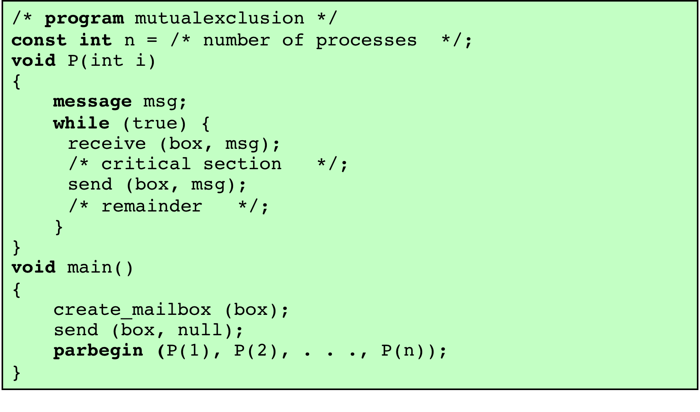
Figure 5.20
Mutual Exclusion Using Messages
Notes:
Figure 5.20 shows one way in which message passing can be used to enforce mutual exclusion (compare Figures 5.1 , 5.2 , and 5.6 ). We assume the use of the blocking receive primitive and the nonblocking send primitive. A set of concurrent processes share a mailbox, box , which can be used by all processes to send and receive.
The mailbox is initialized to contain a single message with null content. A process wishing to enter its critical section first attempts to receive a message. If the mailbox is empty, then the process is blocked. Once a process has acquired the message, it performs its critical section and then places the message back into the mailbox. Thus, the message functions as a token that is passed from process to process.
The preceding solution assumes that if more than one process performs the receive operation concurrently, then:
• If there is a message, it is delivered to only one process and the others are
blocked, or
• If the message queue is empty, all processes are blocked; when a message is
available, only one blocked process is activated and given the message.
These assumptions are true of virtually all message-passing facilities.

Slide 37
Class Activity 4 Session id: 169-822-228
In process synchronisation,, when both sender and receiver are blocked until the message is delivered is sometimes referred to as ____________
https://ulsteruniversity.display.vevox.com/#/present/408996/1WJ6X5N2FE2LX19R4IDC

Slide 38
Summary
The central themes of operating system design are all concerned with the management of processes and threads.
As an extension of the principles of modular design and structured programming, some applications can be effectively programmed as a set of concurrent processes.
Concurrent processes can come into conflict with each other when they are competing for the use of the same resource.
A process that is waiting for access to a critical section does consume processor time.
One of the most common problems faced in concurrent processing is the producer/consumer problem.
Processes need to be synchronized to enforce mutual exclusion.
Atomic Operation occurs when the sequence of instruction is guaranteed to execute as a group, or not execute at all, having no visible effect on system state.
A situation in which a runnable process is overlooked indefinitely by the scheduler, although it is able to proceed, is Starvation.

